Slide 1
Creating Express JS Application – Step 10

Slide 2
Express JS
Express Module : Express Module is third party module base upon the http module.
Which help to create node JS web application and REST full API very easily.
Other third party node js web framework.
Express.js- Express for Everyone
Koa.js- Next Generation Node.js Framework
Meteor.js- One Application, One Language
Socket.io- Chat Apps Made Easy with Socket.io
Nest.js- A Nestling of Code
Sails.js- Modernized Data-Oriented MVC Framework
Total.js- A Complete Framework
Hapi.js- Secure than Ever

Slide 3
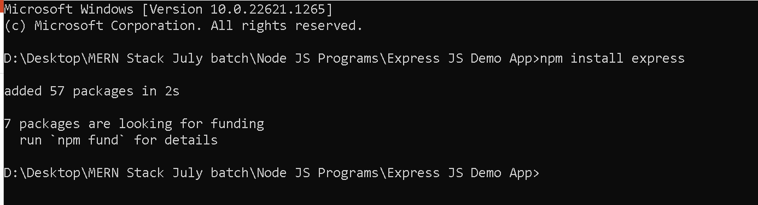
Express js
Express is third party module so whenever we are creating application using express module we have to install this module.
npm install express

Slide 4
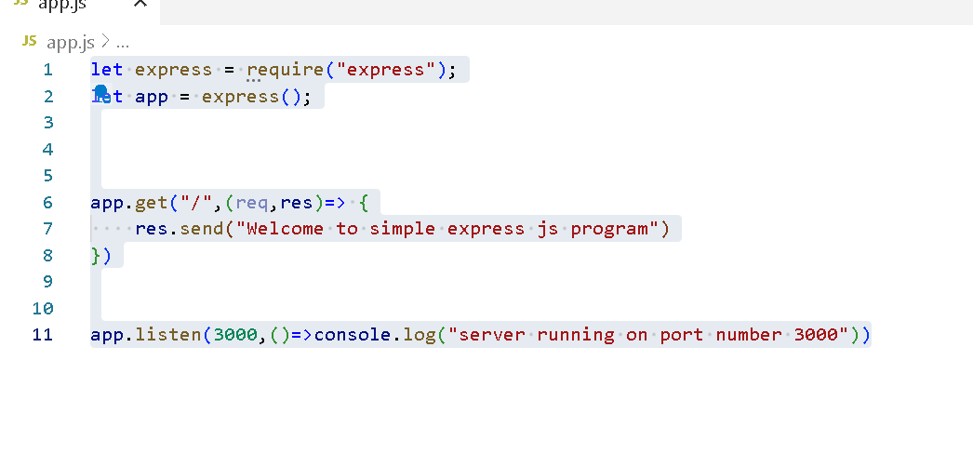
Write simple express program

Slide 5
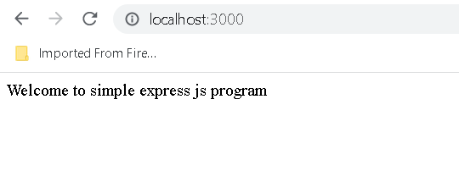
Run this application using command as

Slide 6
Creating static web page as well as login page and checking user details using express js
First install npm install express
Then create the app.js file

Slide 7
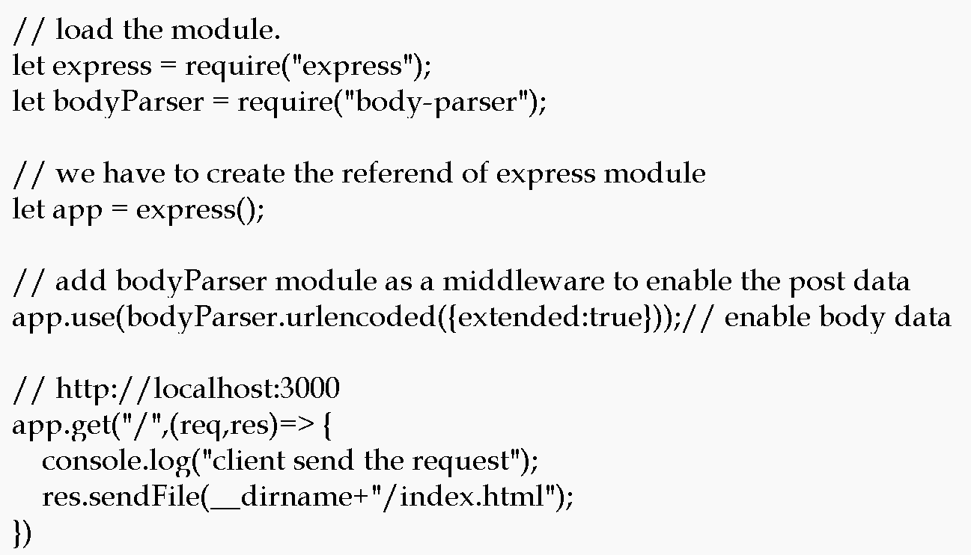

Slide 8
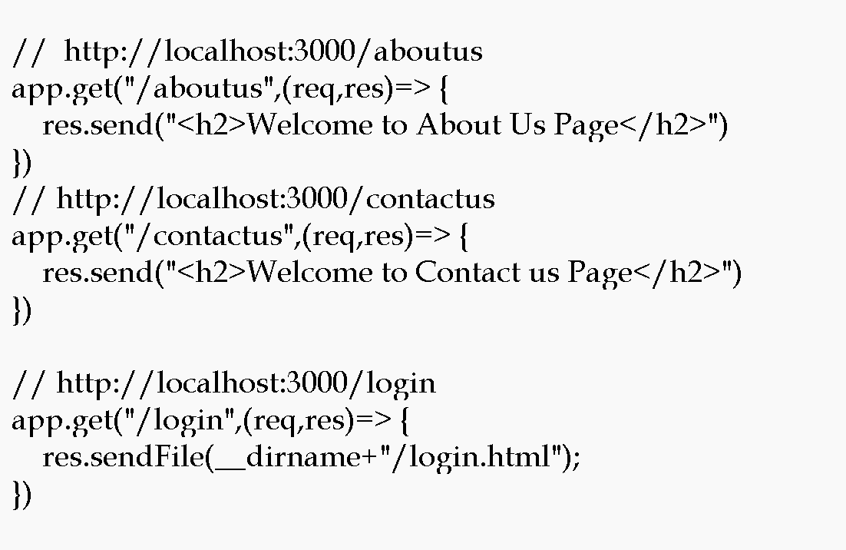

Slide 9
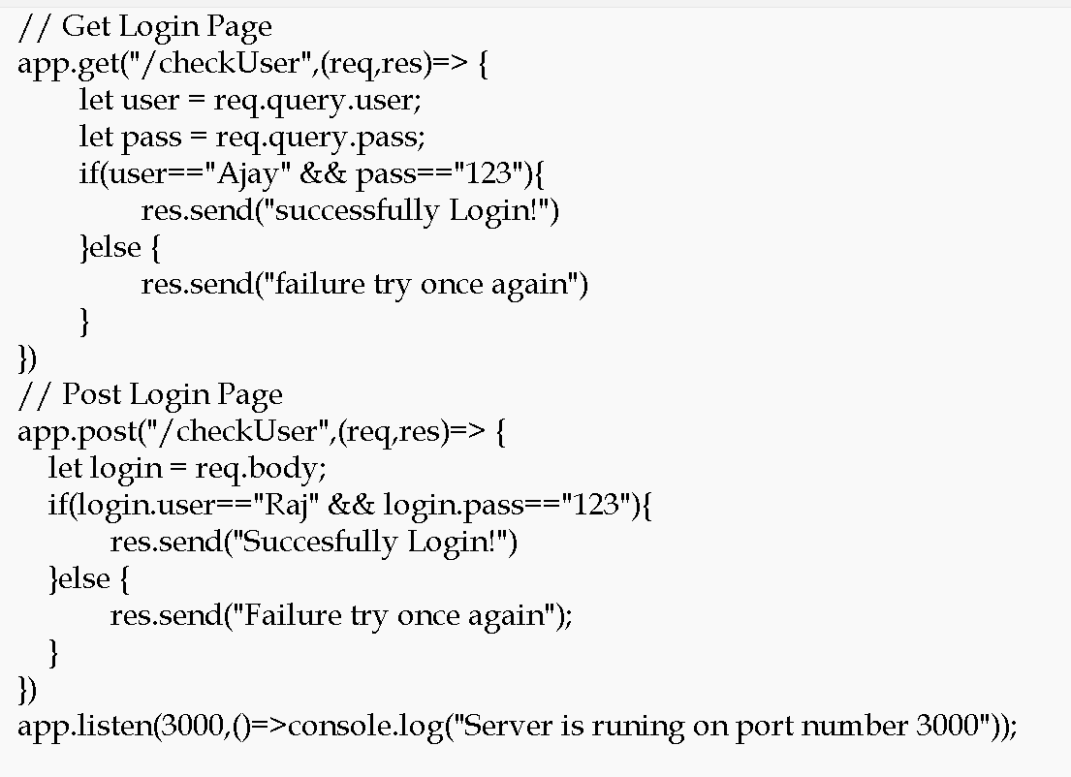

Slide 10
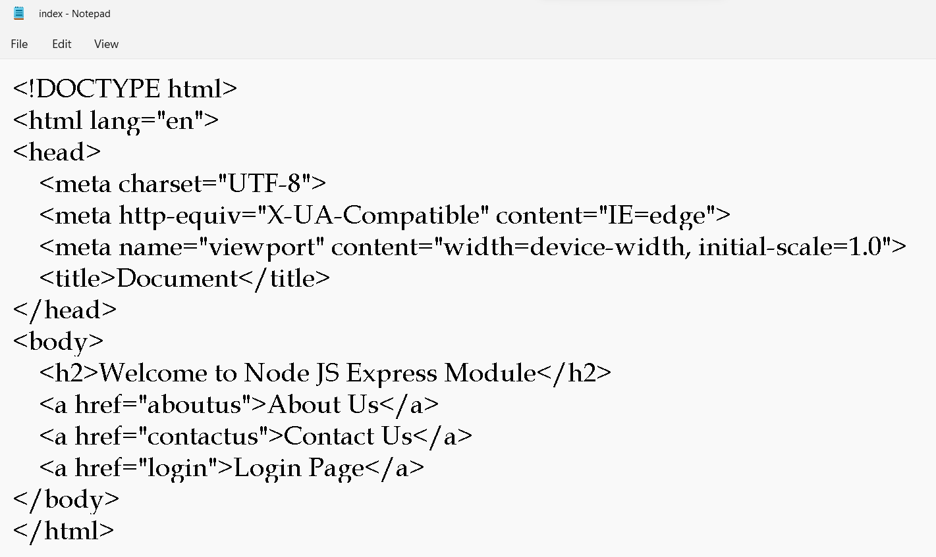
Then create two html pages ie index.html and login.html

Slide 11
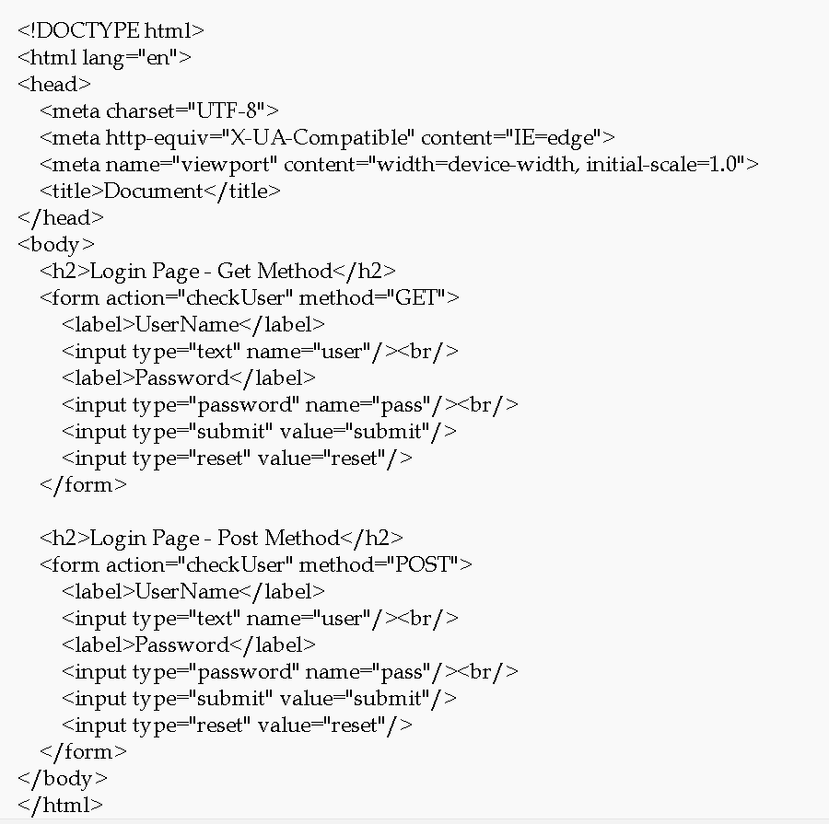

Slide 12
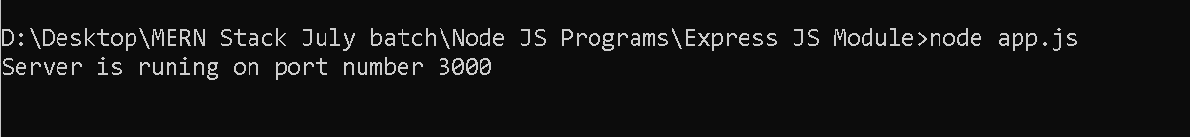
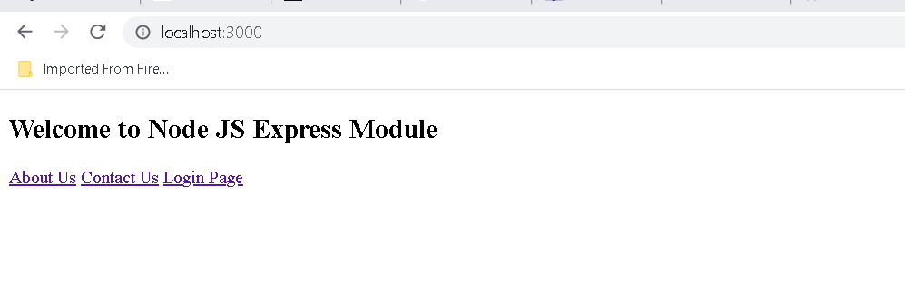

Slide 13
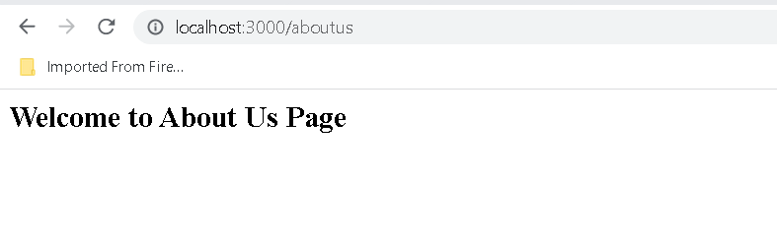
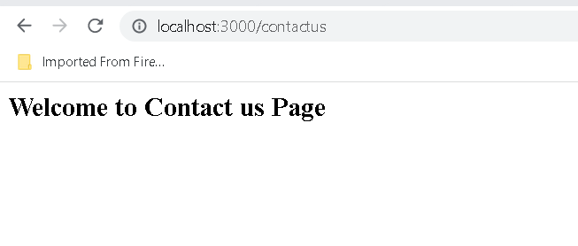
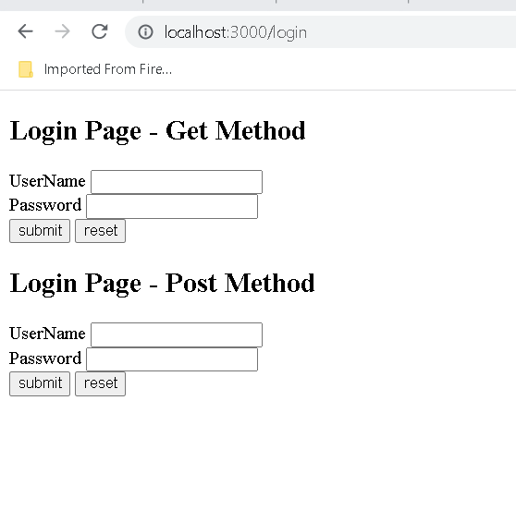

Slide 14
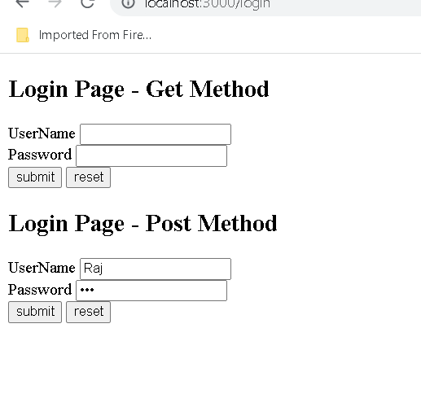
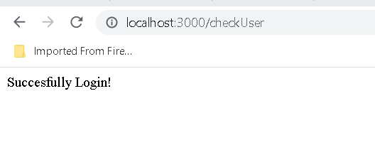
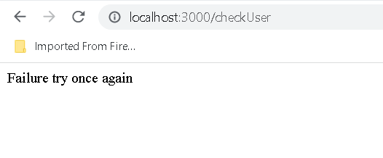

Slide 15
Creating REST API Using Express JS
Create folder as Express JS REST API
Install express js module
Then create the app.js file
We are creating Rest API using
Get Method : Get resources
Post method : Create resources
Put method : Update resources
Delete method : Delete resources

Slide 16
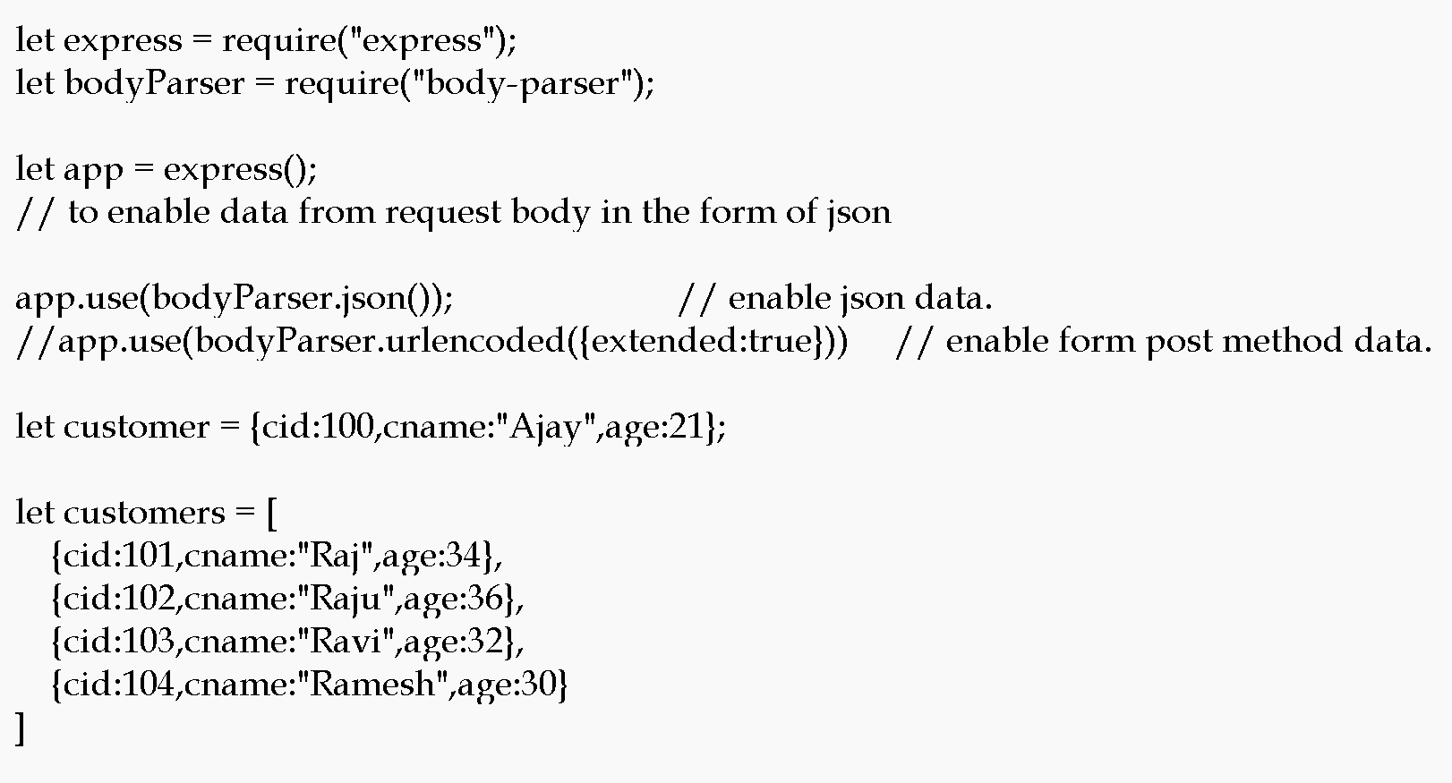

Slide 17
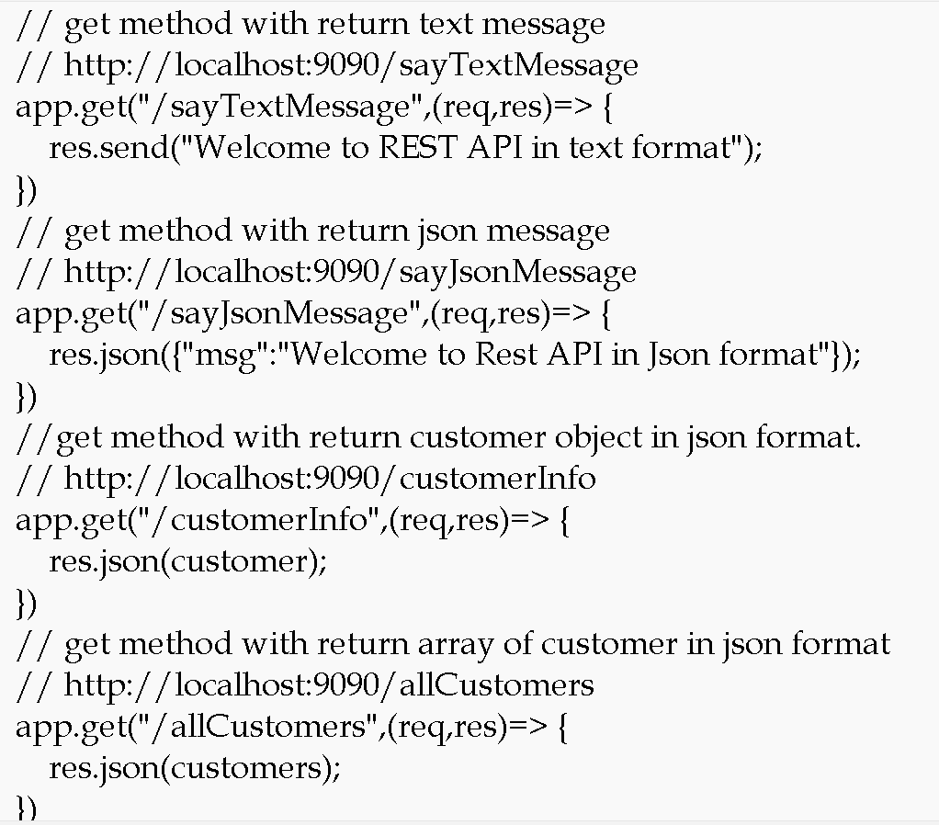

Slide 18
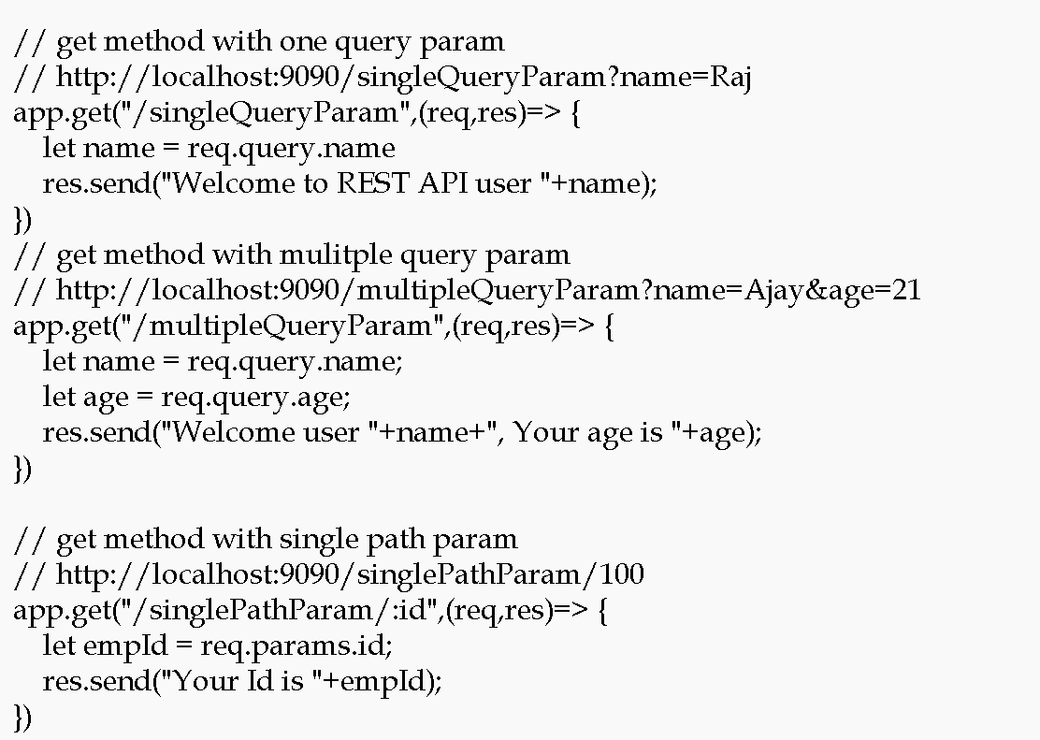

Slide 19
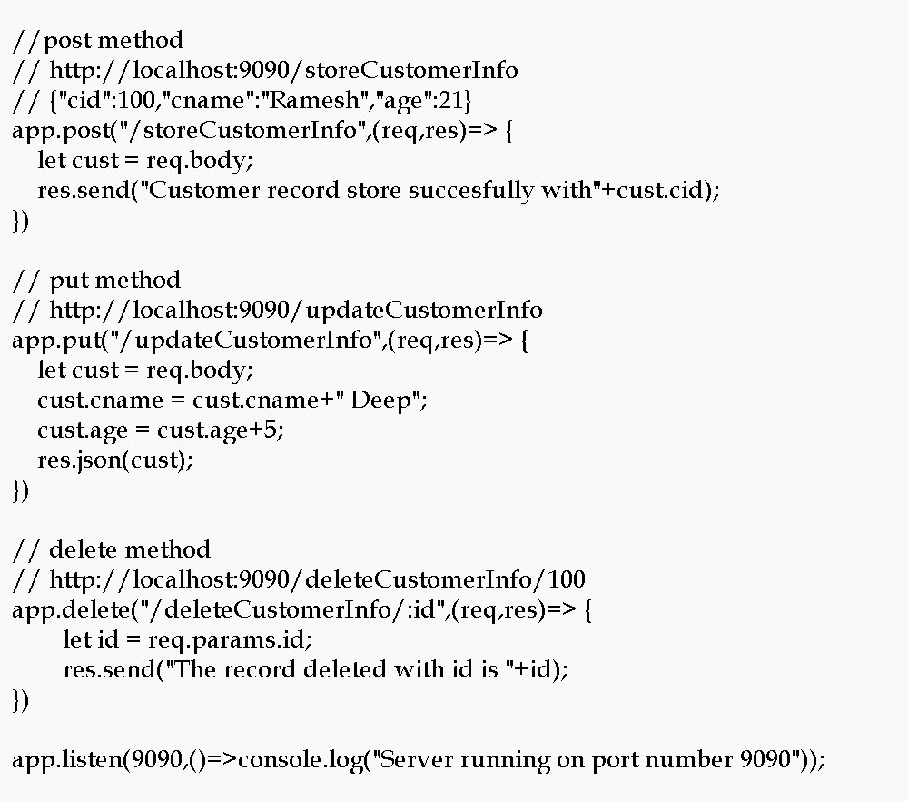

Slide 20
Testing rest api
These all rest api we can’t test except get method through browser. So we can check the rest api using rest client tool.
We can use any tool
Like browse depends tool like ARC or post man
Command prompt tool like ssh client ie git bash
So we are using git bash to check these rest api using curl

Slide 21
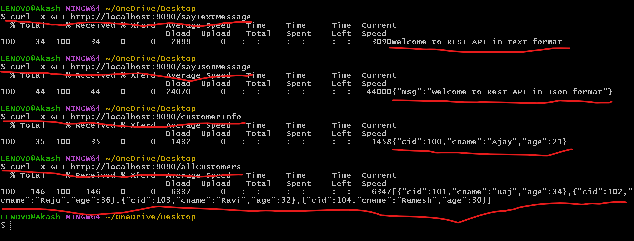
Get methods using git bash client

Slide 22
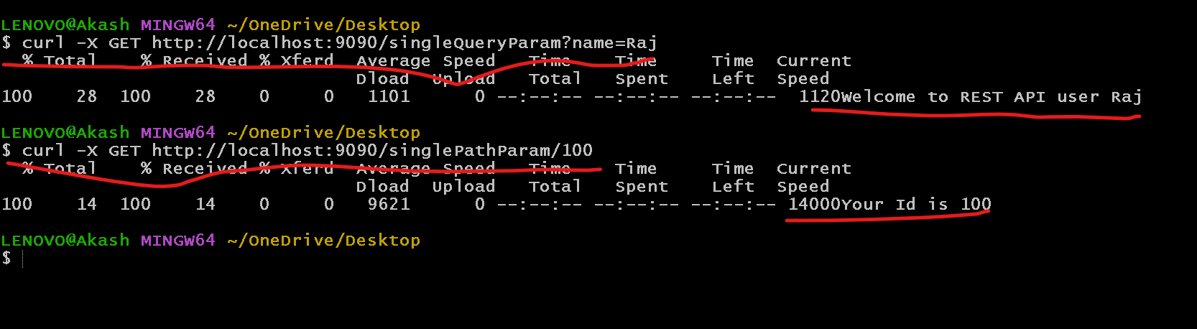
Get method query param and path param

Slide 23
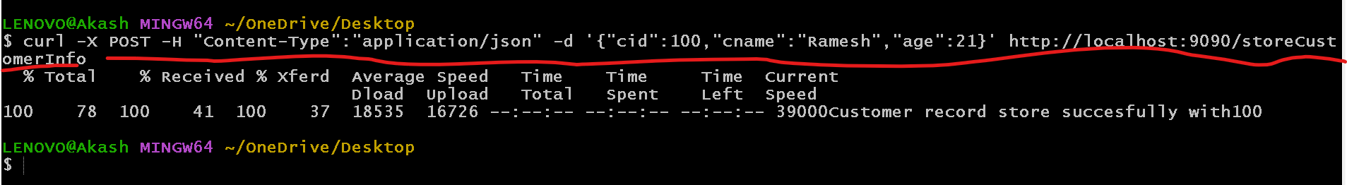
Post method
curl –X POST –H “content-type:application/json” –d ‘{“cid”:100,”cname”:”Ravi”,”age”:21}’ http://localhost:3000/storeCustomerInfo

Slide 24
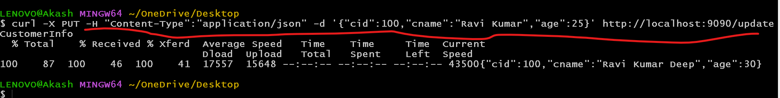
Put method
curl –X PUT –H “content-type:application/json” –d ‘{“cid”:100,”cname”:”Ravi Kumar”,”age”:26}’ http://localhost:3000/storeCustomerInfo

Slide 25
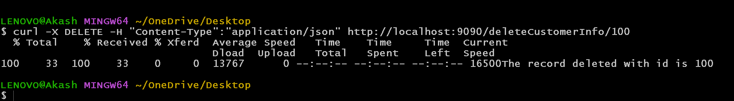
Delete method
curl –X DELETE –H “content-type:application/json” http://localhost:3000/deleteCustomerInfo/100

